Slide 1
Data Mining Applications in Open-World Games
Clustering Player Behavior to Understand Immersion

Slide 2
Table of contents
01
02
03
04
05
06
Results
Motivation
Immersion & Player Data
Dataset & Features
Methodology
Evaluation
Contact and next steps

Slide 3
01
Motivation

Slide 4

Motivation
Modern open-world games generate massive amounts of player behavior data.
Examples:
Player movement
Combat activity
Dialogue choices
Exploration patterns

Slide 5
WHY PLAYER DATA MATTERS
Player behavior data reveals how players interact with open-world systems.
Key insights from player data:
Different playstyles emerge naturally
Engagement patterns become visible
Design strengths and weaknesses are exposed
Understanding behavior is the first step toward understanding immersion.

Slide 6
02
IMMERSION IN OPEN-WORLD RPGs

Slide 7

IMMERSION IN OPEN-WORLD RPGs
Immersion describes how deeply players feel part of the game world.
Core components:
Freedom of exploration
Meaningful player choices
Reactive environments
Strong sense of player agency

Slide 8
03
PLAYER TELEMETRY DATA

Slide 9

PLAYER TELEMETRY DATA
Open-world games collect behavioral features such as:
Exploration hours
Combat encounters
Side quests completed
Dialogue choices
Fast travel usage
Crafting actions
Dataset used in this project is synthetic, inspired by real RPG telemetry.

Slide 10
PROBLEM FORMULATION
Can we automatically identify different player playstyles using data mining?
Unsupervised learning problem
No predefined labels
Goal: discover hidden player groups

Slide 11
04
METHODOLOGY

Slide 12
METHODOLOGY
Our data mining pipeline consists of:
Synthetic data generation
Feature standardization
K-Means clustering
PCA visualization
Elbow method & Silhouette score

Slide 13
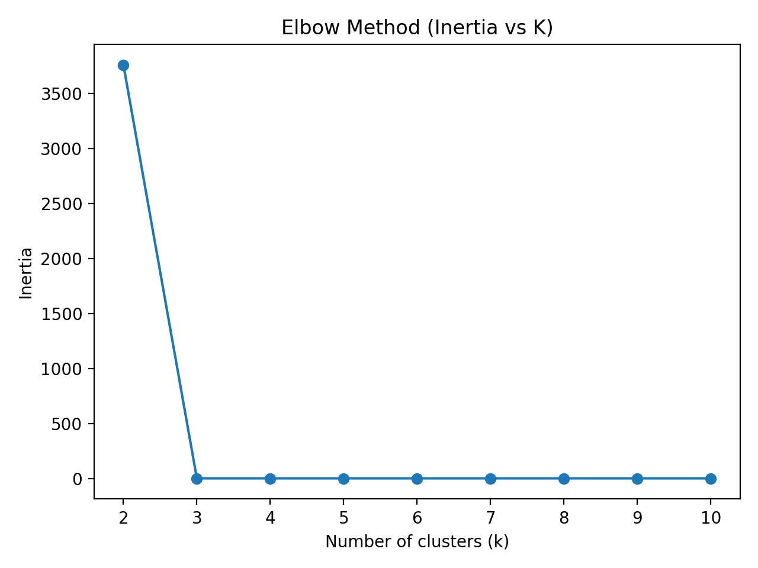
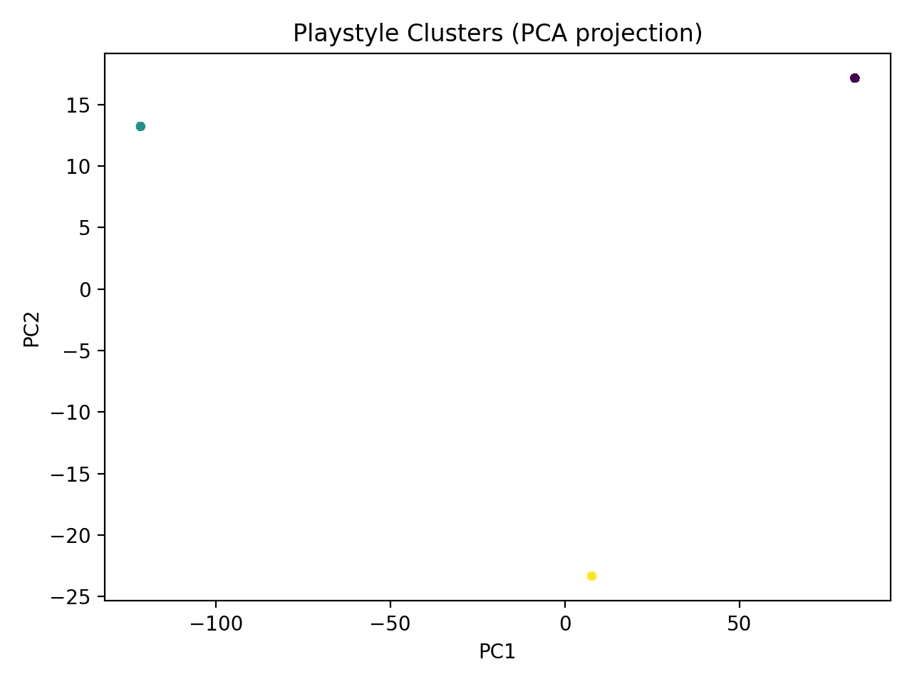
Elbow Method
PCA Visualization of Player Clusters
Elbow Method
Inertia decreases sharply until k = 3
Improvements flatten after this point
→ Optimal number of clusters: k = 3
PCA Visualization of Player Clusters
Each point represents a player
Colors indicate cluster membership
Clear separation between clusters

Slide 14
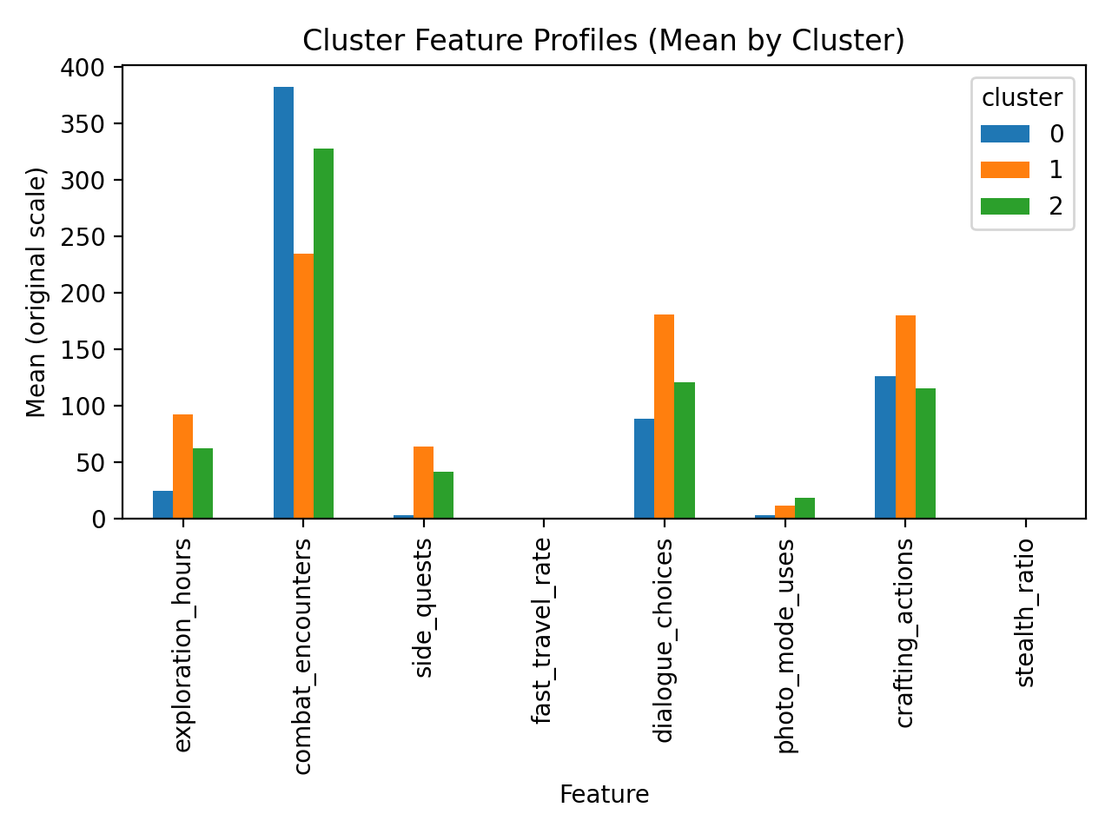
CLUSTER INTERPRETATION
Cluster 1 — Explorer
Cluster 2 — Combat-Focused
Cluster 3 — Narrative / Completionist
High exploration time
Low fast travel usage
High combat encounters
Direct, action-oriented gameplay
High side-quest completion
Many dialogue choices

Slide 15

APPLICATIONS IN GAME DESIGN

Slide 16
APPLICATIONS IN GAME DESIGN
Data mining insights can support:
Quest pacing optimization
Content personalization
Difficulty balancing
DLC and expansion planning

